Slide 1
Transition to Post-Secondary
2024-2025

Slide 2
Guidance Team
Mr. Briglio (A-B) joseph.briglio@ocdsb.ca
Ms. Killen (C-J) laura.killen@ocdsb.ca
Ms.Tremblay (K-N) amy.tremblay@ocdsb.ca
Ms. Savage (O-Z) crystal-lee.savage@ocdsb.ca
Ms. Schliebener - Guidance Assistant and Technician ghsguidance@ocdsb.ca

Slide 3
Overview
Graduation Requirements
Pathway Options
Research Your Choice - check prerequisites
Application Process for College and Universities
Next Steps
Questions???

Slide 4
Graduation Requirements
30 Credits (18 compulsory and 12 elective)
Community Service
40 hours for 2025 Graduates
Submit hours using paper form (in Guidance) to Main Office
Volunteer Ottawa
Successful completion of the Literacy Test (OSSLT) or the Literacy Course (OLC4O)
2 e-learning credits
Must be asynchronous courses
Can complete the opt-out form

Slide 5
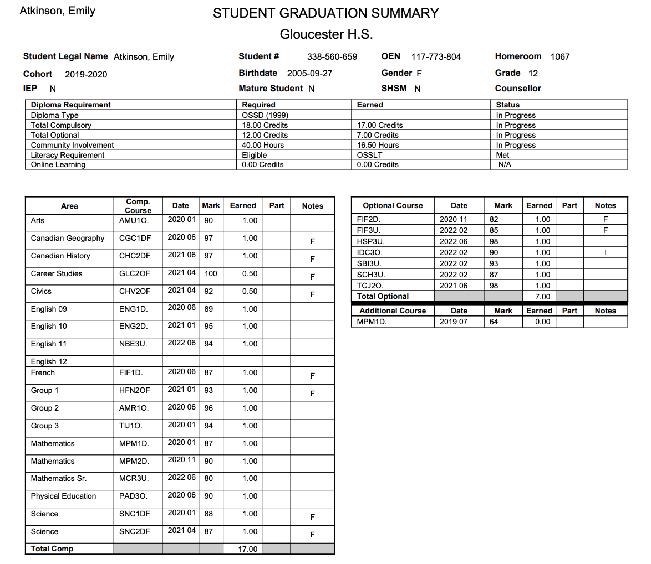
Community Service Hours
Literacy Requirement
*** REMEMBER***
Post-Secondary requirements are based on your program choice.
Make sure you are registered in all required courses for your program.
30 or more credits
18 compulsory
12 electives

Slide 6
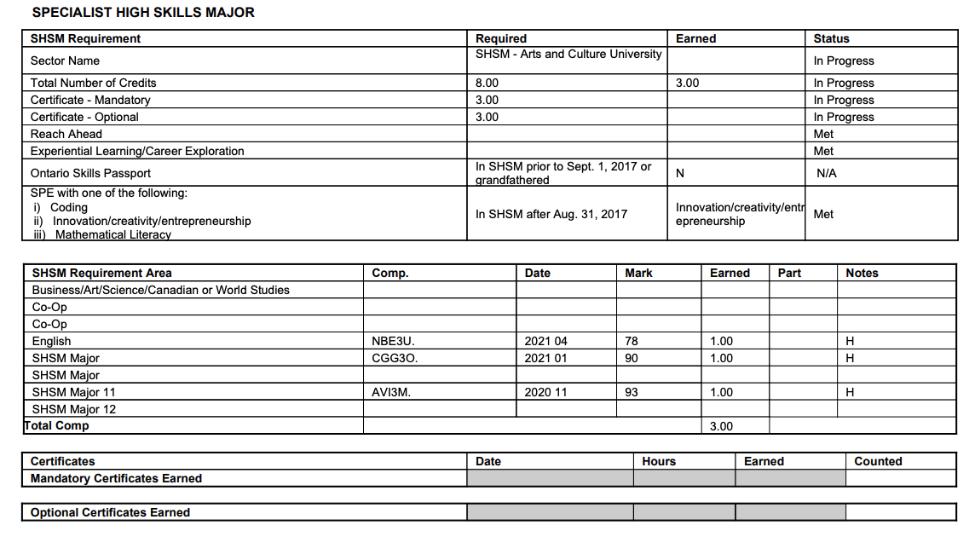
SHSM Diploma
Make sure you are on track with completing all of the requirements:
English (1)
Math (1)
Majors (4)
Other required course (1)
Co-op
Certifications
*If you attended LAUNCH this will count as the “Reach Ahead” Component

Slide 7
What are your options?
Apprenticeship
University
Gap Year
Military
Source: www.time4learning.com/blog/new-homeschooler/life-after-high-school-different-paths-to-success/

Slide 8
Explore the pathways!

Slide 9
Research: Gap Year
During a Gap Year you can:
Travel
Volunteer
Upgrade your courses (via GHS, Adult HS, ILC.org or other online schools)
Work
Join a structured Gap Year Program - For example, Discover Year or CAN GAP (Canadian Gap Year association)

Slide 10
Research: Apprenticeship
What is an Apprenticeship?
On-the-job PAID training provided by an employer
Technical training from a college, vocational school or union training centre
Check out:
Apprenticeships in Ontario
Canadian Apprenticeship Forum

Slide 11
Research: Colleges in Ontario
Search by program, credential (degree, diploma, certificate), or college
ontariocolleges.ca

Slide 12
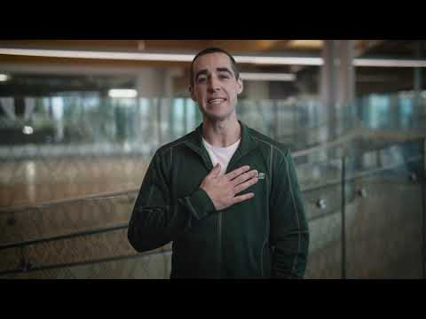
Research: Colleges in Ontario
Attend virtual college visits or visit in-person!
Connect with Ontario Colleges Ontario College Fair (in Toronto) October 16-17
Algonquin College Events Ottawa Campus - Nov.9 (10am-2pm)
Algonquin College Recruitment Representative: Erik Franz

Slide 13
Research: Universities in Ontario
Search by program or university
https://www.ontariouniversitiesinfo.ca/

Slide 14
Check out these new programs being offered at Carleton University - Fall 2025
Bachelor of Science in Nursing (3 year program - MHF4U required, supplemental application - resume and statement of intent, Learn and Stay Grant)
Bachelor of Accounting (leads to CPA)
Bachelor of Cybersecurity
Bachelor of Data Science
Bachelor of Science in Mechatronics Engineering
Attend their virtual information session on December 11, 2024 at 5:00pm to learn more about these great programs.

Slide 15
Research: Universities in Ontario
Attend school based University visits!
These are ongoing and posted on the Grade 12 Google Classroom. Check in with Ms.Schliebener if you want to know about a specific school.
Visit campuses for in-person tours
U Ottawa Open House - March 22nd
Carleton University Open House - March 8
Ontario Regional OUF Fair (September 23-26)
Ontario Universities’ Information Sessions - Nov. 21 @ 5-7pm (virtual)
Attend the Aboriginal Post-Secondary Information Session - Nov. 4-8

Slide 16
More Research
Algonquin College Career Coach
Accessibility and disabilities support - Paul Menton (Carleton),
Centre for Accessible Learning (Algonquin)
Enriched Support Program (ESP) and Indigenous Enriched Support (IESP) @ Carleton
ESL support for English Language Learners
College → University transfer opportunities

Slide 17
Other things to consider:
What do you want to study/to do in the future?
What are you good at? What is your passion?
Where do you want to live?
How much money do you have/can you borrow?
Compare Universities and programs (check different rankings and consider the criteria)
What courses would you have to take?
Talk to people who know about your chosen career path.

Slide 18
Application Process
College and University

Slide 19
Application Information and Deadlines
Ontario Colleges → OPEN NOW! https://ontariocolleges.ca/en Deadline: February 1, 2025
Ontario Universities → OPEN NOW! https://www.ouac.on.ca/ Deadline: January 15, 2025 (NEW!!! NO PIN required)
Out-of-Province → check with individual schools (both colleges and universities) as dates may vary. Some have agreements with OUAC (Dalhousie, Concordia, McGill, Bishop’s, UBC, Simon Fraser, Victoria, Calgary) but apply to Ontario Universities first to link applications.
Notes:
Western Universities have a later application deadline.
Nursing: apply to Ottawa U. and Algonquin, and Pembroke campuses through OUAC.
Averages on electronicinfo.ca are only a general guideline.

Slide 20
College: General Admission Requirements
For most Certificate or Diploma Programs:
OSSD - Ontario Secondary School Diploma + ENG4C
Specific Grade 11 or 12 courses may be required (ie.Health Sciences)
Supplementary applications may be required for specific programs (ie. portfolio, audition, entrance exam, police record check) and possibly TOEFL/IELTS for English Language Learners
Some colleges also offer DEGREE Programs (ie.Algonquin) that have different requirements.

Slide 21
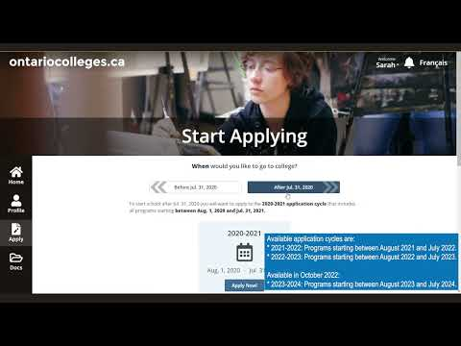
Applying to Ontario Colleges
(OCAS)
Apply @ ontariocolleges.ca
Use this application for all Ontario College programs
For out-of-province colleges, apply directly on their website

Slide 22
College: What you need to apply
Consider making a non-ocdsb email account
Create an account using your legal name as it appears on your legal documents (ie.Health Card, PR Card, etc).
OEN (Ontario Education Number) - found on report cards and credit counselling summaries
Payments can be done online, by phone or certified cheque
COST: $150 for 5 Program choices (no more than 3/college)

Slide 23
College: Application TIPS
Record your username/password and security answers
Some programs are “Highly Competitive”
Verify additional requirements (ie. Health Sciences → HPAT test )
Don’t be shy to reach out to the college if you have questions
Have a back-up plan!
The fee covers 5 Program Choices - apply to at least 3 programs

Slide 24
College: Important Dates
Applications are open NOW - you can start applying. Some colleges may send early offers even in November.
February 1, 2025 → Deadline for Equal Consideration
May 1, 2025 → Accept your offer by this date (unless offer is made after May 1)
Mid-June 2025 → Non-refundable tuition deposit (varies in date/amount by college). If this is not paid, you can lose your offer.

Slide 25
University: General Admission Requirements
For most University or College DEGREE Programs :
OSSD - Ontario Secondary School Diploma + Six (6) Grade 12 courses at the U/M* level including ENG4U + any other required courses (used to calculate average) *Check each school - some require a minimum number of 4U courses (McGill requires 4, Queen’s requires 3, etc.)
Supplementary applications may be required for specific programs (ie. portfolio, audition, entrance exam, police record check) and possibly TOEFL/IELTS for English Language Learners

Slide 26
University: General Admission Requirements
You cannot apply for Early Admission
Based on exceptionally high Grade 11 marks or first semester Grade 12 marks
A conditional offer of acceptance is not a guarantee; the offer can be rescinded if final Grade 12 grades do not meet the required standard.
Arts programs hear earlier than those who have portfolio, auditions, or Calculus as a prerequisite.
Maritime Universities respond earlier but their deadline to accept an offer is before Ontario Universities send out their acceptances in April.

Slide 27
Applying to Ontario Universities
Use UNDERGRAD if you are currently in high school
Apply @ https://www.ouac.on.ca/
Use this application for all Ontario University and some College DEGREE programs
For out-of-province colleges, apply directly on their website

Slide 28
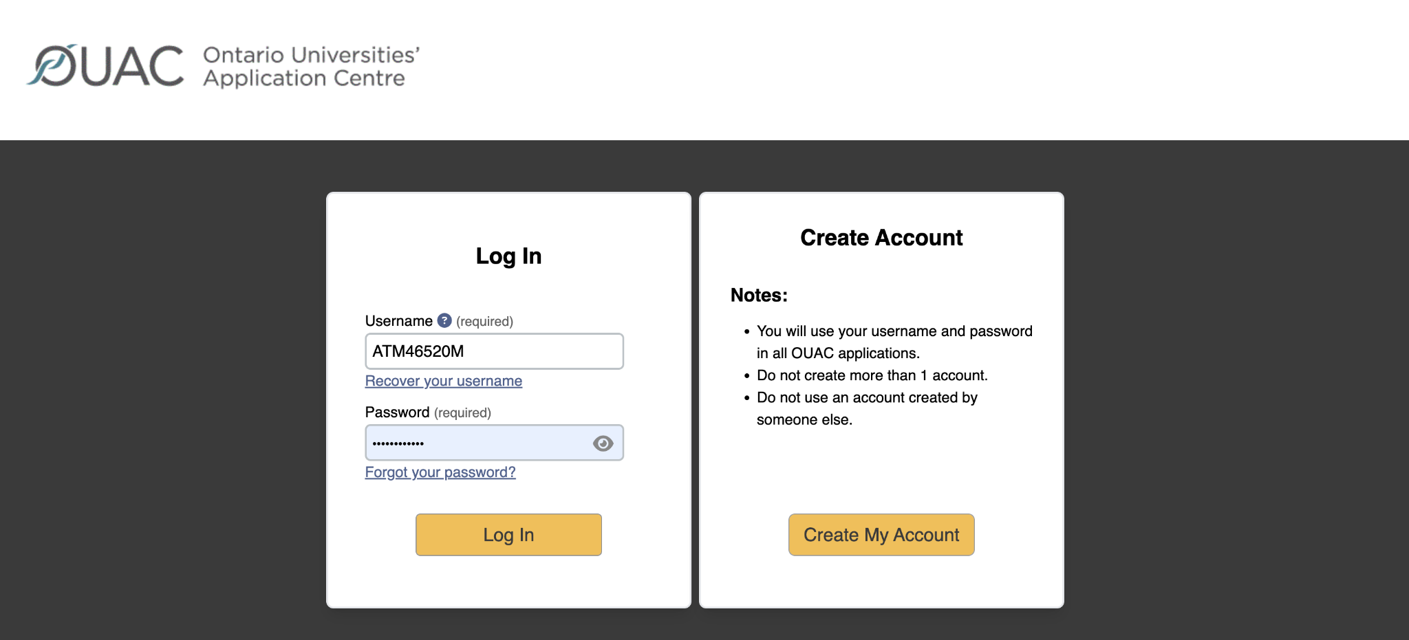
Make an account
How-to Videos: https://www.ouac.on.ca/videos/how-to-videos/

Slide 29
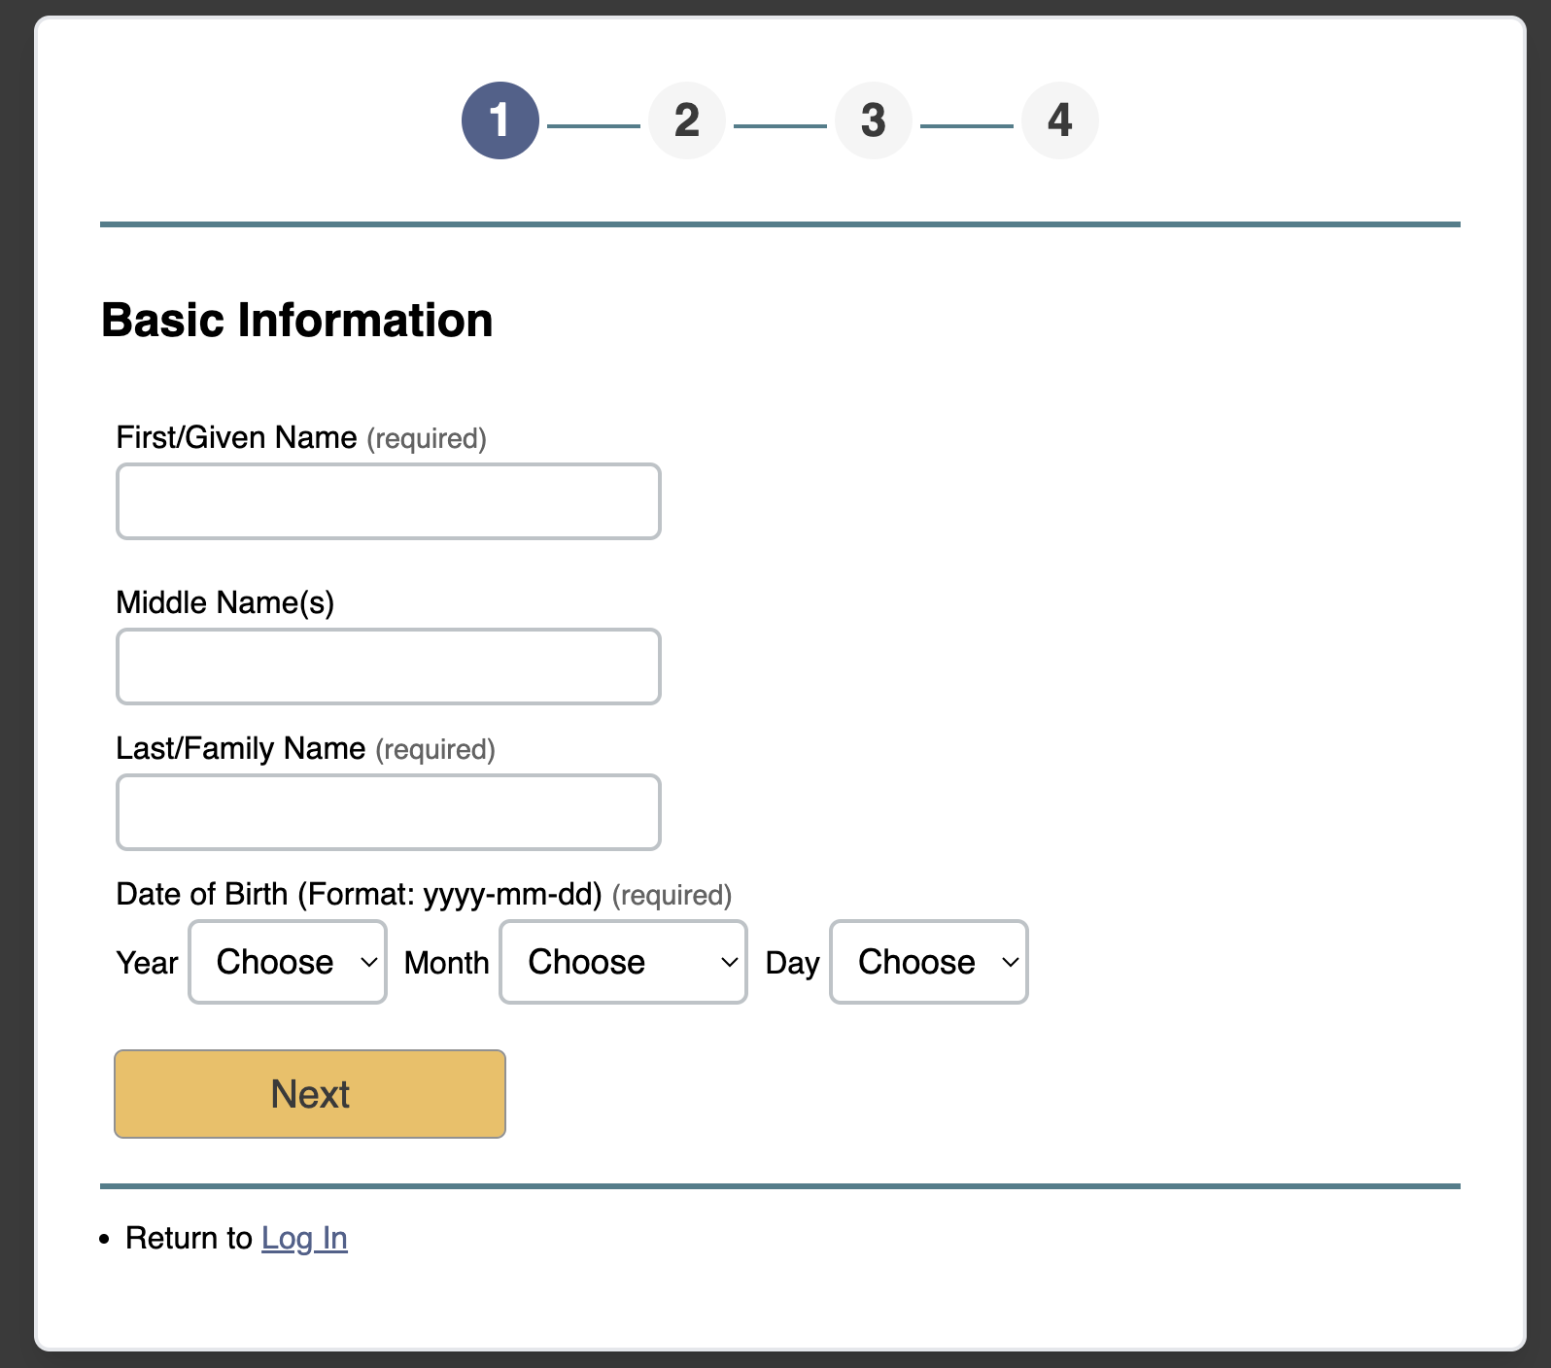
Record this information
OR
take a screenshot!
Use your name as it appears on legal documents ie. Health Card, PR Card, etc.

Slide 30
University: What you need to apply
Consider making a non-ocdsb email account
Create an account using your legal name as it appears on your legal documents (ie.Health Card, PR Card, etc).
Payments can be done online by credit card or online banking
COST: $156 for 3 Program choices. $50 for each additional choice.
Some programs have supplemental fees: https://www.ouac.on.ca/guide/101-fees/ There is no fee for replacing a program choice with another program choice at the same university.
You may apply to as many Ontario universities/programs as you wish; however, you are limited to a maximum of 3 program choices at any 1 university (including its affiliates).

Slide 31
University: Application TIPS
Record your username/password and security answers
Some programs are more competitive or have fewer spaces
Verify that you are registered in all required courses
Don’t be shy to reach out to the universities if you have questions → they want you to come to their school!
Have a back-up plan!
The fee covers 3 Program Choices - DO NOT apply to only ONE program!

Slide 32
University: Important Dates
Applications are open NOW - you can start applying.
January 15, 2025 → Deadline for Applications (Equal Consideration)
Once you apply, you will receive an 11-digit number OUAC Reference Number - record this number!
May 29, 2025 → Latest date for Ontario university decisions to be released (offer, refusal, or deferral)
June 2, 2025 → Earliest date a response may be required for offers of admission and financial commitment (tuition deposit, residence deposit, etc.)

Slide 33
Ontario Universities: Notes
What will they see?
As soon as you apply, they will see all your grade 11 marks and any completed grade 12s.
In November → midterm marks of Semester 1
In February → final marks of Semester 1
In April → midterm marks of Semester 2
In July → final marks of Semester 2
Taking a summer school course? If you have received a conditional offer, YOU must submit: proof of registration in summer school course (your guidance counsellor can send a letter, but you must ask for this) and your final mark. These go directly to the university.

Slide 34
Full Disclosure Deadlines
Full-disclosure deadline means that when a course is dropped after that date, the course will show up on the student’s transcript with a “W” for “withdrawal” and their midterm or most recent mark.
The dates are as follows:
Semester 1: November 25, 2024
Semester 2: May 7, 2025
Full Year: February 21, 2025

Slide 35
Ontario Universities: Notes
How do they calculate your average?
Averages are based on top 6 marks (4U/4M) including prerequisites.
Some programs have minimum averages for specific courses.
Offers
Review each university’s policies on alternate offers, repeated courses and deferrals
Offers and scholarships are CONDITIONAL
Rounds of Offers: December, February and May (and July if availability)
Arts programs (not Fine Arts) usually receive offers before programs that require portfolios, auditions or Calculus
Maritime (Eastern) universities tend to send offers earlier but also require a response before Ontario universities have sent out all offers.

Slide 36
Ontario Universities: Notes
Are you an English Language Learner?
You may be required to provide proof of language proficiency (IELTS/TOFEL)
Usually if you are in Canada for three years or more, you are exempt
University of Ottawa exemption with 80% + in ENG4U (you must request exemption
Register early for your test. Deadlines vary but generally early April for your final result
Bridge programs are sometimes available
Do you have an IEP?
This might carry with you to university depending on the assessments and accommodations you have had.

Slide 37
Ontario Universities’ Indigenous Student Resources
OUISR provides information about supports and services for Indigenous students interested in, or already attending, an Ontario university.
Students can find information about: academics, admissions, financial aid, housing, Indigenous student services, student life and well-being.
OUISR also features videos of Indigenous role models who have achieved success in postsecondary education in Ontario.
Students can learn about how to connect with Indigenous university representatives in a city near them.
Visit: www.ontariouniversitiesindigenous.ca

Slide 38
Applying to U.S. Schools
SAT or ACT test scores may or may not be required - check with each school. If required, and you have not yet written them, please see your guidance counsellor.
Most applications are done on the Common App or Universal College App These applications are much more comprehensive than Ontario Universities applications, so get started!
If interested - Education USA has some great resources!

Slide 39
Next Steps

Slide 40
So you’ve completed your application...now what?
Check your OCAS (college) or OUAC (university) accounts for updates
CHECK your email. READ all messages from colleges/universities and follow instructions for next steps and deadlines
Schools will send a confirmation email that contains information about accessing their student portals in order to submit other required documents or information
Start or continue doing research about scholarships and funding options
Keep working hard to maintain your average
Find time to enjoy your last year of high school, relax and have fun

Slide 41
Financing Post-Secondary
We will be having a “Scholarship, Bursary and OSAP” Presentation later in the year but we know some of you are eager to get started! Check out:
Scholarships Canada
Yconic
Scholar Tree
Gloucester HS website
Grade 12 Google Classroom
Scholarships (updated by RHS)
More info about school specific scholarships and awards to come in Spring 2024.

Slide 42
Need help?
Ms.Schliebener in Guidance can help you - make an appointment.
Connect with colleges and universities
Understand the application process
With scholarships and bursary information
Process transcript requests for out-of-province applications
E-mail GHSguidance@ocdsb.ca
Make an appointment with your guidance counsellor by sending them an e-mail or using the posted QR codes

Slide 43
Reminders!
Visit the OPEN HOUSE at UOttawa, Carleton and Algonquin
Ontario Universities’ Fairs Virtual Events November 21 @ 5-7pm
Hand in your volunteer hours!
Check your graduation summaries! Make sure you have everything you need for the programs you are applying to! These will be given out to around mid-term.

Slide 44
QUESTIONS?

